Slide 1
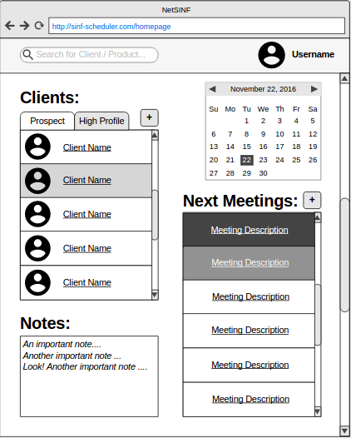
ID CORE VIEW: HOM_PAGE
Homepage: Overview of schedule.
INWARD PATHS:
- Sign In;
- Home Button.
OUTWARD PATHS:
- Allows user to
quickly verify future meetings and take relevant notes if necessary;
- Enables scheduling of new meetings with existing clients;
- Allows user to add new clients and easily access their information.
ELEMENTS OF THE CORE: Clients Grid, Meetings List, Meetings Calendar, Note Text Area
Notes:
Alterar client list para algo com os tabs: prospect e high profile (ou semelhante)
1

Slide 2
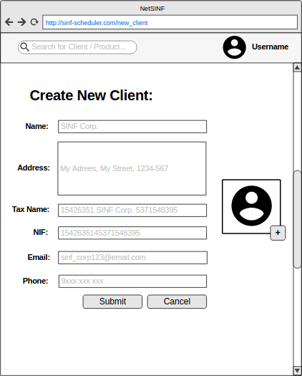
ID CORE VIEW: NEW_CLI
New Client Page: Create page for new potential client.
INWARD PATHS:
- Homepage.
OUTWARD PATHS:
- Allows the creation of new clients.
ELEMENTS OF THE CORE: New Client Form
Notes:
2

Slide 3
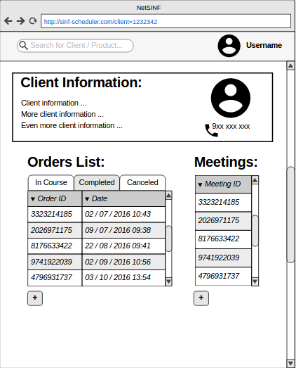
ID CORE VIEW: CLI_PAGE
Client Page: Display of client information and order history.
INWARD PATHS:
- Homepage;
- Meeting Page;
- Order Page.
OUTWARD PATHS:
- Allows the user to see detailed client information;
- Displays complete history of pending, completed and canceled orders;
- Allows starting a new order with the client;
- Display history of meetings with client;
- Allows scheduling a new meeting with the client.
ELEMENTS OF THE CORE: Client Information Summary, Order Information Table,
Context Tabs and New Order Button
Notes:
Talvez acrescentar uma lista das reuniões mais recentes (ou algo como previous meeting e next meeting)
3

Slide 4
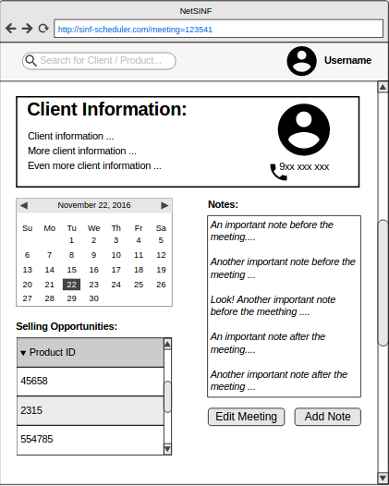
ID CORE VIEW: VIE_PAGE
Meeting Page: Overview of meeting.
INWARD PATHS:
- Homepage;
- Client Page.
OUTWARD PATHS:
- Allows the user to see detailed client information;
- Allows the user to take relevant notes after the meeting;
- Shows the detailed list of selling opportunities proposed to the client;
- Enables editing the meeting date and time as well as add new notes.
ELEMENTS OF THE CORE: Client Information Summary, Meeting Calendar,
Notes Text Area and Selling Opportunities List, Edit and Add Buttons
Notes:
Condensar as notas numa só caixa
4

Slide 5
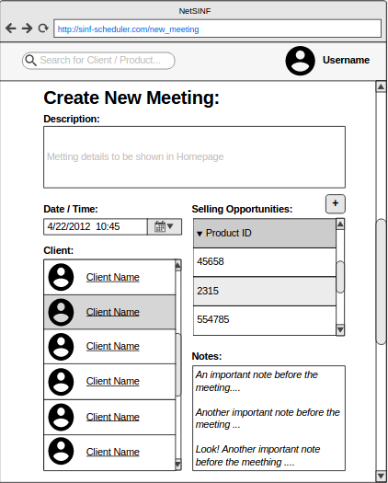
ID CORE VIEW: NEW_MEE
New Meeting Page: Schedule meeting with client.
INWARD PATHS:
- Homepage;
- Client Page;
OUTWARD PATHS:
- Enables the scheduling of new meetings with clients;
- Verifies if different meetings do not overlap each other;
- Enables to select the products to sell and access their respective pages;
- Enables to take important notes before the meeting.
ELEMENTS OF THE CORE: Description Text Area, Meeting Data Picker,
Client List, Selling Opportunities List
Notes:
Date/time
5

Slide 6
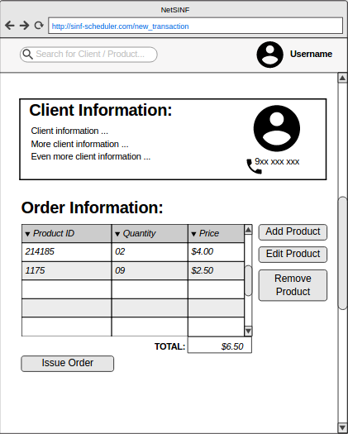
ID CORE VIEW: NEW_TRA
New Order Page: Sell products to client.
INWARD PATHS:
- Client Page;
- Meeting Page.
OUTWARD PATHS:
- Allows user to see specific information about the client;
- Enables the creation of complete orders;
ELEMENTS OF THE CORE: Client Information Summary,
New Order Table, Action Buttons

Slide 7
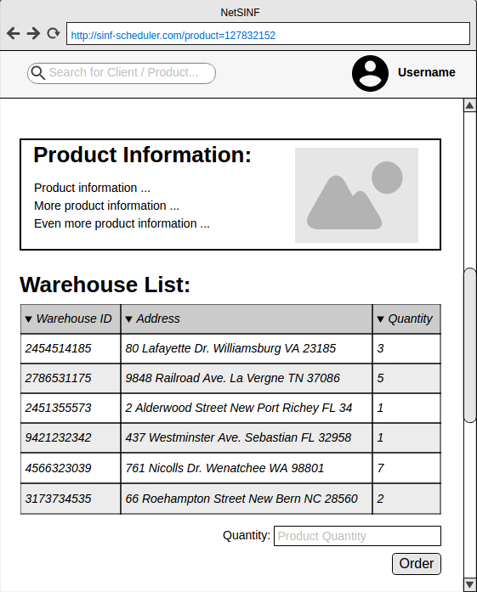
ID CORE VIEW: PRO_PAGE
Product Page: Overview of product.
INWARD PATHS:
- Order Page;
- Meeting Page;
OUTWARD PATHS:
- Enables user to see detailed information about a product;
- Enables the user to check availability of a product in several warehouses and respective stock;
- Enables user to request a defined quantity of product units;
ELEMENTS OF THE CORE: Product Information Summary, Warehouse Table

Slide 8
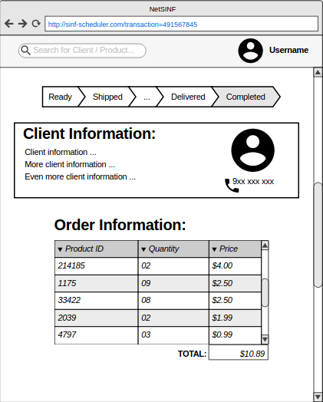
ID CORE VIEW: TRA_PAGE
Order Status Page: Overview of order status.
INWARD PATHS:
- Client Page.
OUTWARD PATHS:
- Allows the user to see the order status;
- Enables user to access client information;
- Enables user to see detailed information of order;
ELEMENTS OF THE CORE: Status Bar, Client Information Summary,
Order Information Table

Slide 9
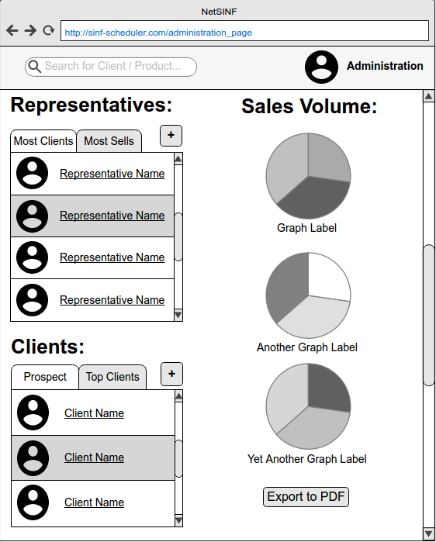
ID CORE VIEW: ADMIN_PAGE
Administration Page: Overview of sales and sales team
INWARD PATHS:
- Sign In.
OUTWARD PATHS:
- Allows the user to see the sales representatives with the most clients or with the largest sales volume;
- Allows the user to see prospect clients or with the largest sales volume;
- Enables the user to see an overview of sales, including the best selling products.
ELEMENTS OF THE CORE: Sales Represenatives List, Clients List, Sales Overview

Slide 10
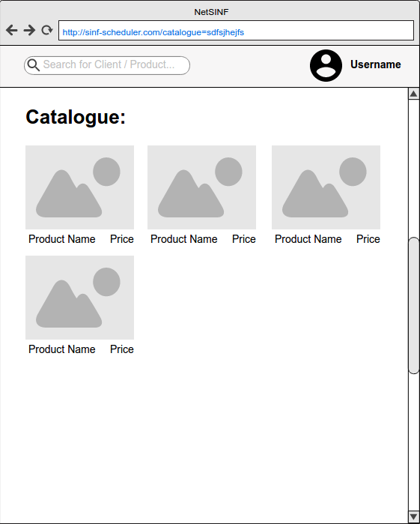
ID CORE VIEW: CAT_PAGE
Catalogue Page: List of products
INWARD PATHS:
-Meeting Page;
-Administration Page;
-Search.
OUTWARD PATHS:
- Allows the user to see the products for sale in detail.
ELEMENTS OF THE CORE: Product List

